Slide 1
ALS Furnace Sequence Passport
Automated Anomaly Detection
Ayoub Bellouch
Mohamed Yassine EL IDRISSI
09/07/2025

Slide 2
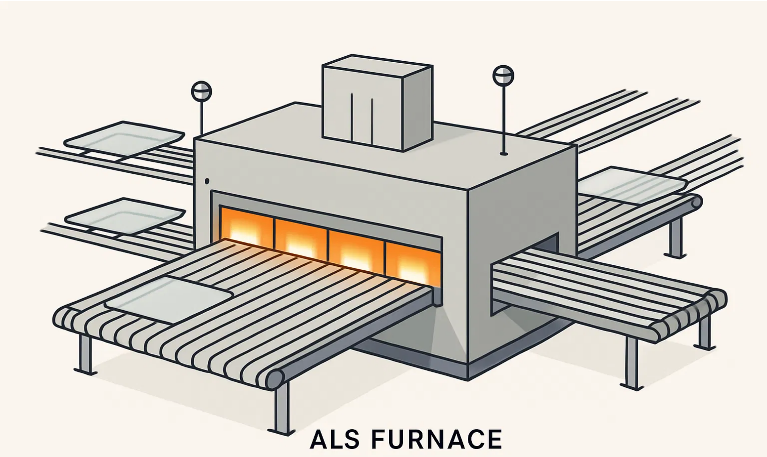
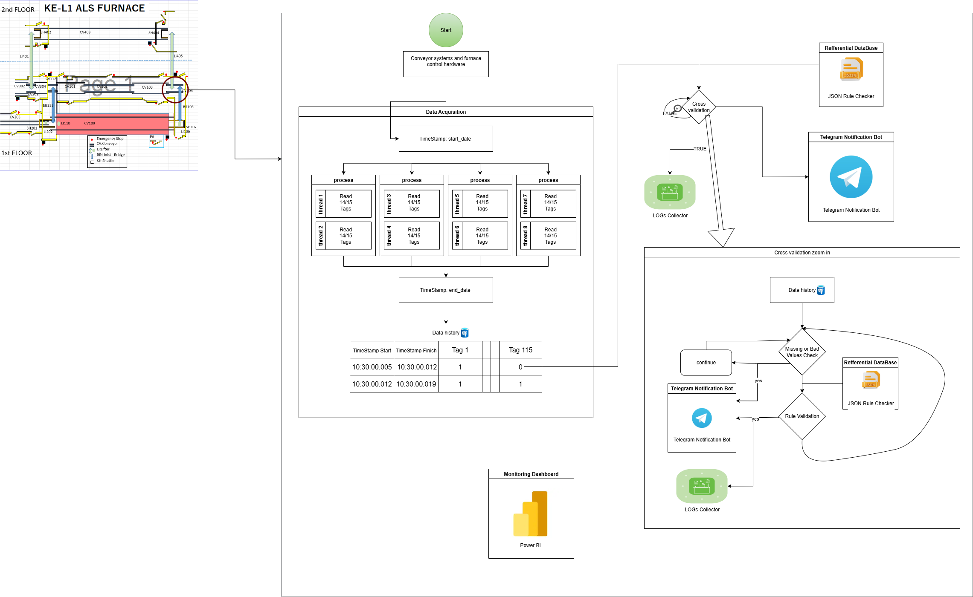
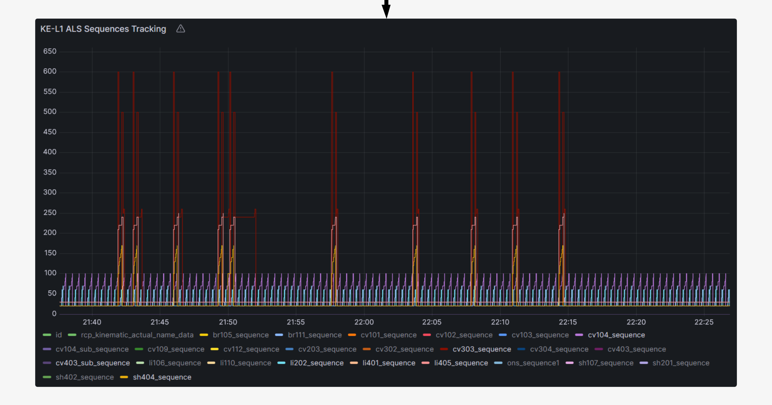
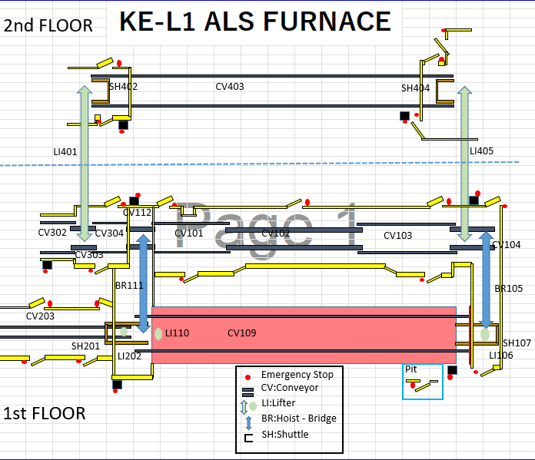
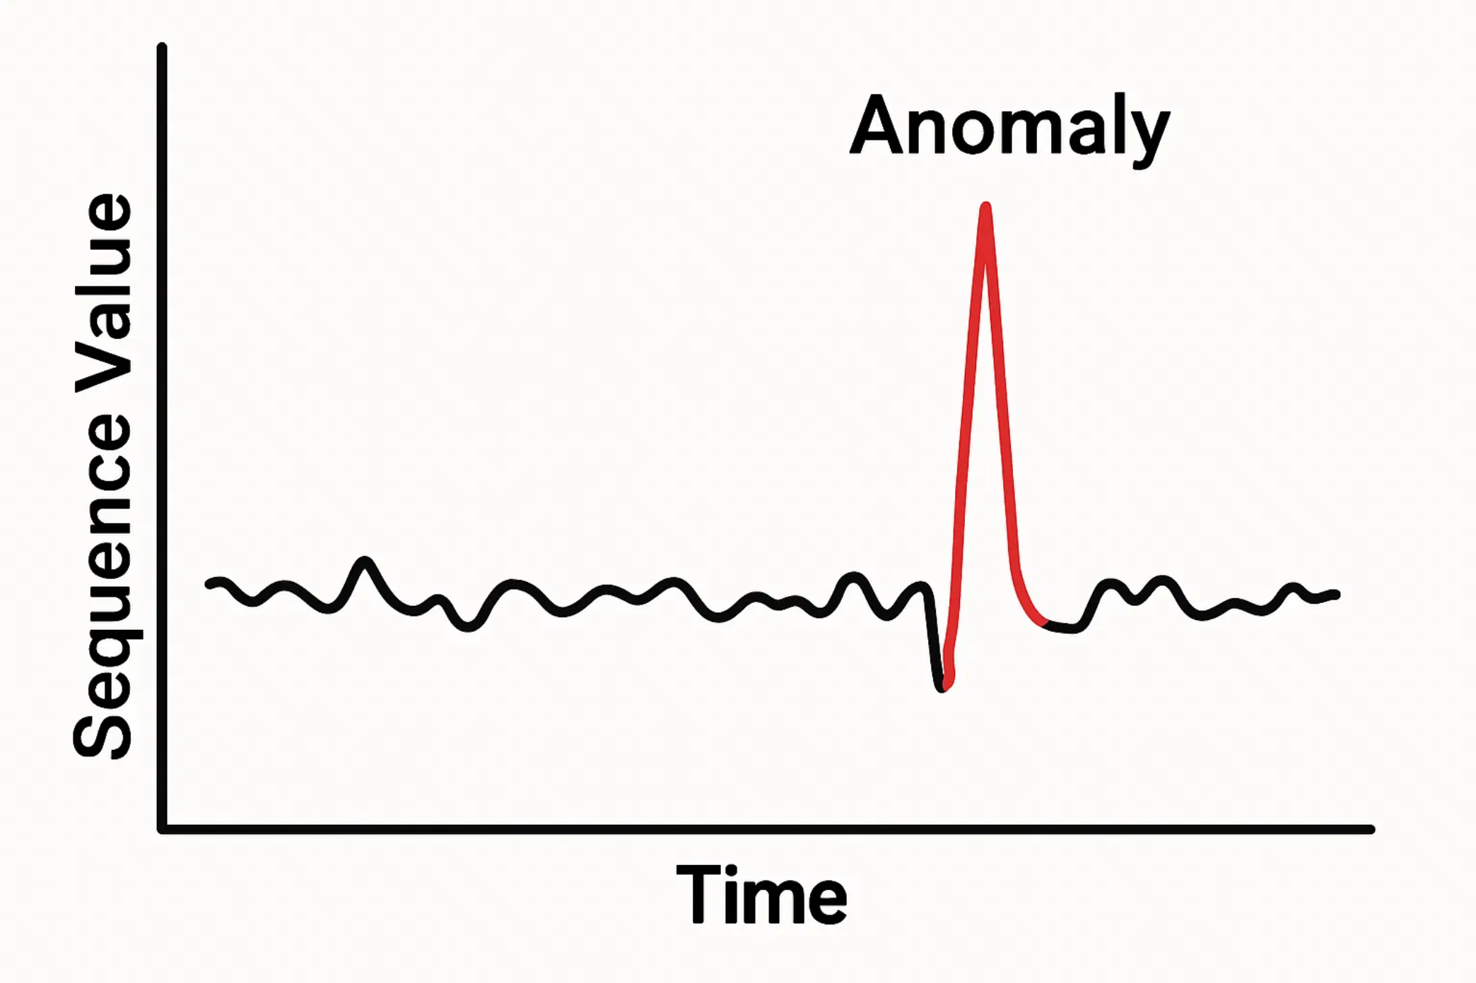

The ALS Furnace Automated Anomaly Detection
Epic Description
Epic pictures (Visible improvements)
Problem description :
The ALS (Advanced Lamination System) Furnace is a critical component in the production line that shapes automotive glass through a sophisticated thermal process. With 2500 electrical resistances across 20 zones and 500 thermocouples for monitoring, this system processes glass through preheating, shaping, and cooling phases to create precisely formed windshields. As the production line's bottleneck, any furnace stoppage directly impacts overall productivity.
Currently, we face significant challenges in responding effectively to system failures, which affects our ability to maintain consistent production flow:
Lack of a centralized view of failure causes across the system
Difficulty in analyzing and understanding failure trends and correlations
Limited tools to support fast, data-driven decision-making
As a result, identifying the root cause of stoppages takes too long, leading to extended downtime, higher scrap, and increased energy consumption
Target description :
Our objective is to build a system that enables real-time monitoring, intelligent failure detection, and better decision-making across the production line.
We aim to:
Develop a centralized monitoring system for the convoying system of the ALS furnace
Automate data collection and visualization of all key sequences and sensor conditions
Enable easy exploration of historical data through smart dashboards
Automatically retrieve and structure data (CSV, JSON, logs) for AI readiness
Identify recurring failure patterns using virtual traceability (linked to zones, components, or conditions)
Improve quality control by reacting faster to anomalies Ultimately, reduce downtime, scrap rates, and energy costs, while delivering more consistent product quality
Scope
This project focuses on the ALS furnace and aims to implement a system for data collection, analysis, visualization and alerting. It will cover the development of tools to process historical and real-time data, define sequence logic and sensor conditions, and support the detection of abnormal behavior. The scope is limited to monitoring and diagnostic support, and does not include changes to the furnace’s automation or control systems.
Epic Owner and Team
Project Owner :
Team :
Epic Results (KPIs/ Savings)
Epic impact : who is affected and how it impacts way of working
Faster failure detection, Scrap & Energy saving
Personal impacted: Laminated team (Process, Production, Quality & Developement)

Slide 3
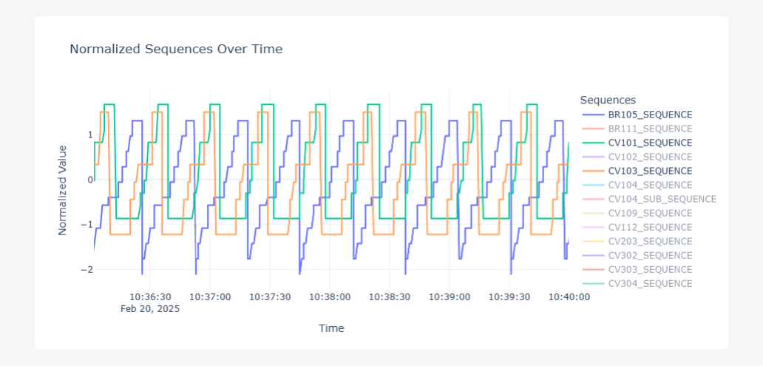
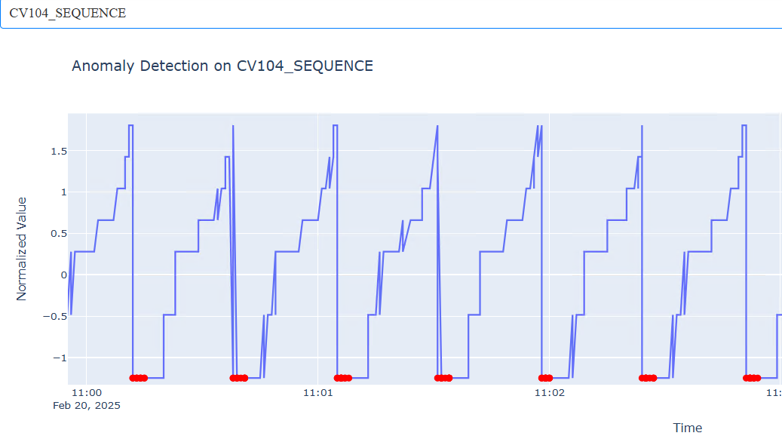
First Approach: Linear Sequence Analysis (Failed)
Our initial approach involved analyzing transitions between sequence steps in a linear way.
Why It Failed
Model too simplistic for a complex system, resulting in numerous false positives and failure to detect real faults.

Slide 4
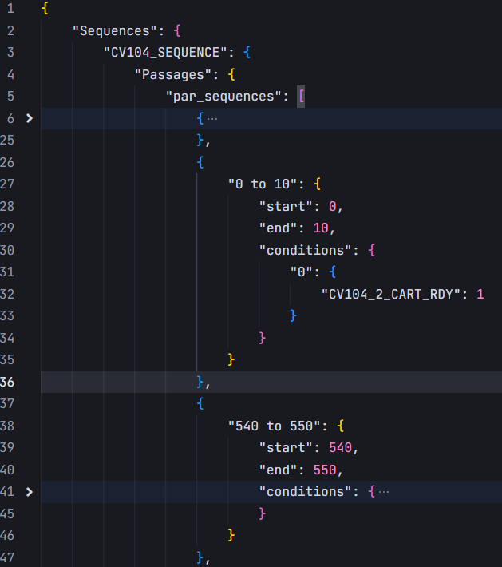
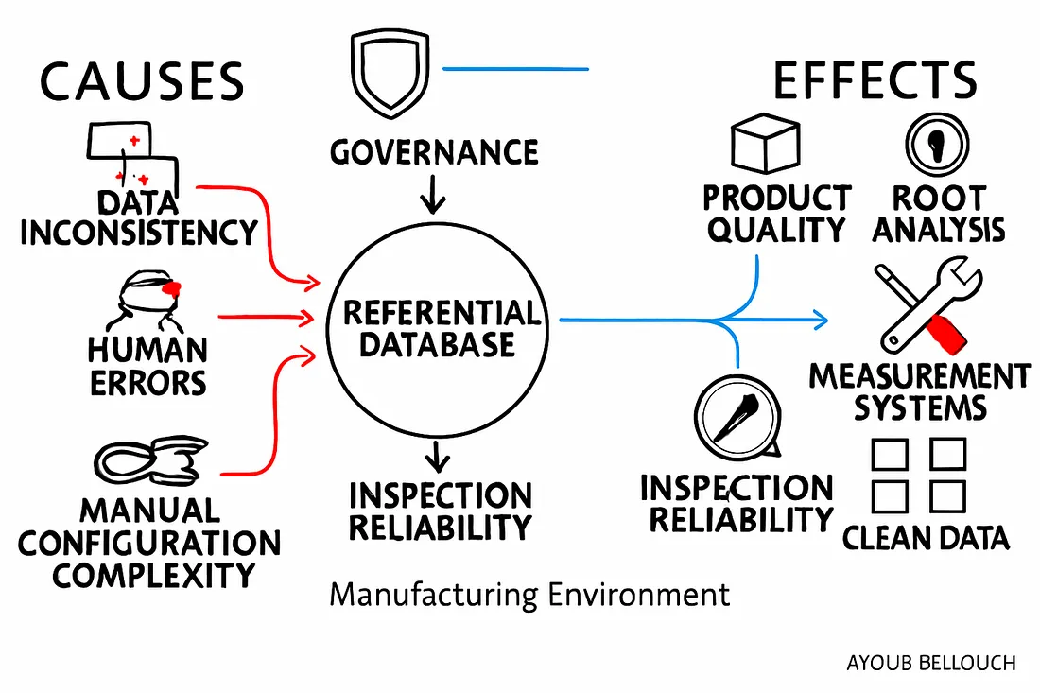
Current Approach: Data-Driven Sequence Dependencies_pilot phase cv104
We shifted our focus to Conveyor 104 as a pilot case, defining all sequences in JSON format with specific conditions.

Slide 5
Leveraging Historical Data for Anomaly Detection
We use Python to read historical data, apply the defined sequence logic, and detect if the correct sequences were active.
Data Processing Pipeline
Collect high-frequency time-series data from conveyor systems
Clean and preprocess data (handling missing values, synchronizing timestamps)
Apply sequence logic rules to identify normal vs. anomalous patterns
Label data for supervised learning approaches
Cleaned Dataset Contains
Timestamps (high precision)
Sensor values (binary and continuous)
Active sequences (e.g., CV104_SEQ_05)
Anomaly labels (for training and validation)

Slide 6
AI Model: Unmasking Hidden Anomalies
We plan to train a machine learning model to detect abnormal transitions, spot missing conditions, and alert operators in real time.
LSTM / GRU
For sequence learning and temporal pattern recognition
Random Forest / XGBoost
Planned Capabilities
For labeled classification with high accuracy
Detect abnormal sequence transitions
Identify missing or incorrect conditions
Real-time alerts to operators
Anomaly scoring and prioritization
Autoencoders
For unsupervised anomaly detection and scoring
Graph Neural Networks
For modeling complex dependencies between sequences

Slide 7
System Architecture: From Data to Insights
System Components
Data Source: PLC/OPC sensor data from the KE-L1 ALS Furnace and conveyor systems
Data Acquisition Engine: Multithreaded and multiprocessed system to collect and store tag data in real-time
Preprocessing Module: JSON rule checker to validate data sequence integrity
Cross-Validation System: Combines logs, rules, and data structure checks
Visualization: Power BI dashboard for real-time monitoring and insights
Notification: Telegram bot sends alerts when validation or rule checks fail
Feedback System: Operators can verify or correct alerts, improving accuracy over time
Data Flow
➤ Real-time collection of tag data using threads and multiprocessing ➤ Data is structured with timestamps and stored in a database/table ➤ Validation of data using JSON rules and logs ➤ If issues found, the Telegram bot sends immediate notifications ➤ Data is visualized in Power BI for human monitoring ➤ Operator feedback is used to refine alerts and improve rule accuracy

Slide 8


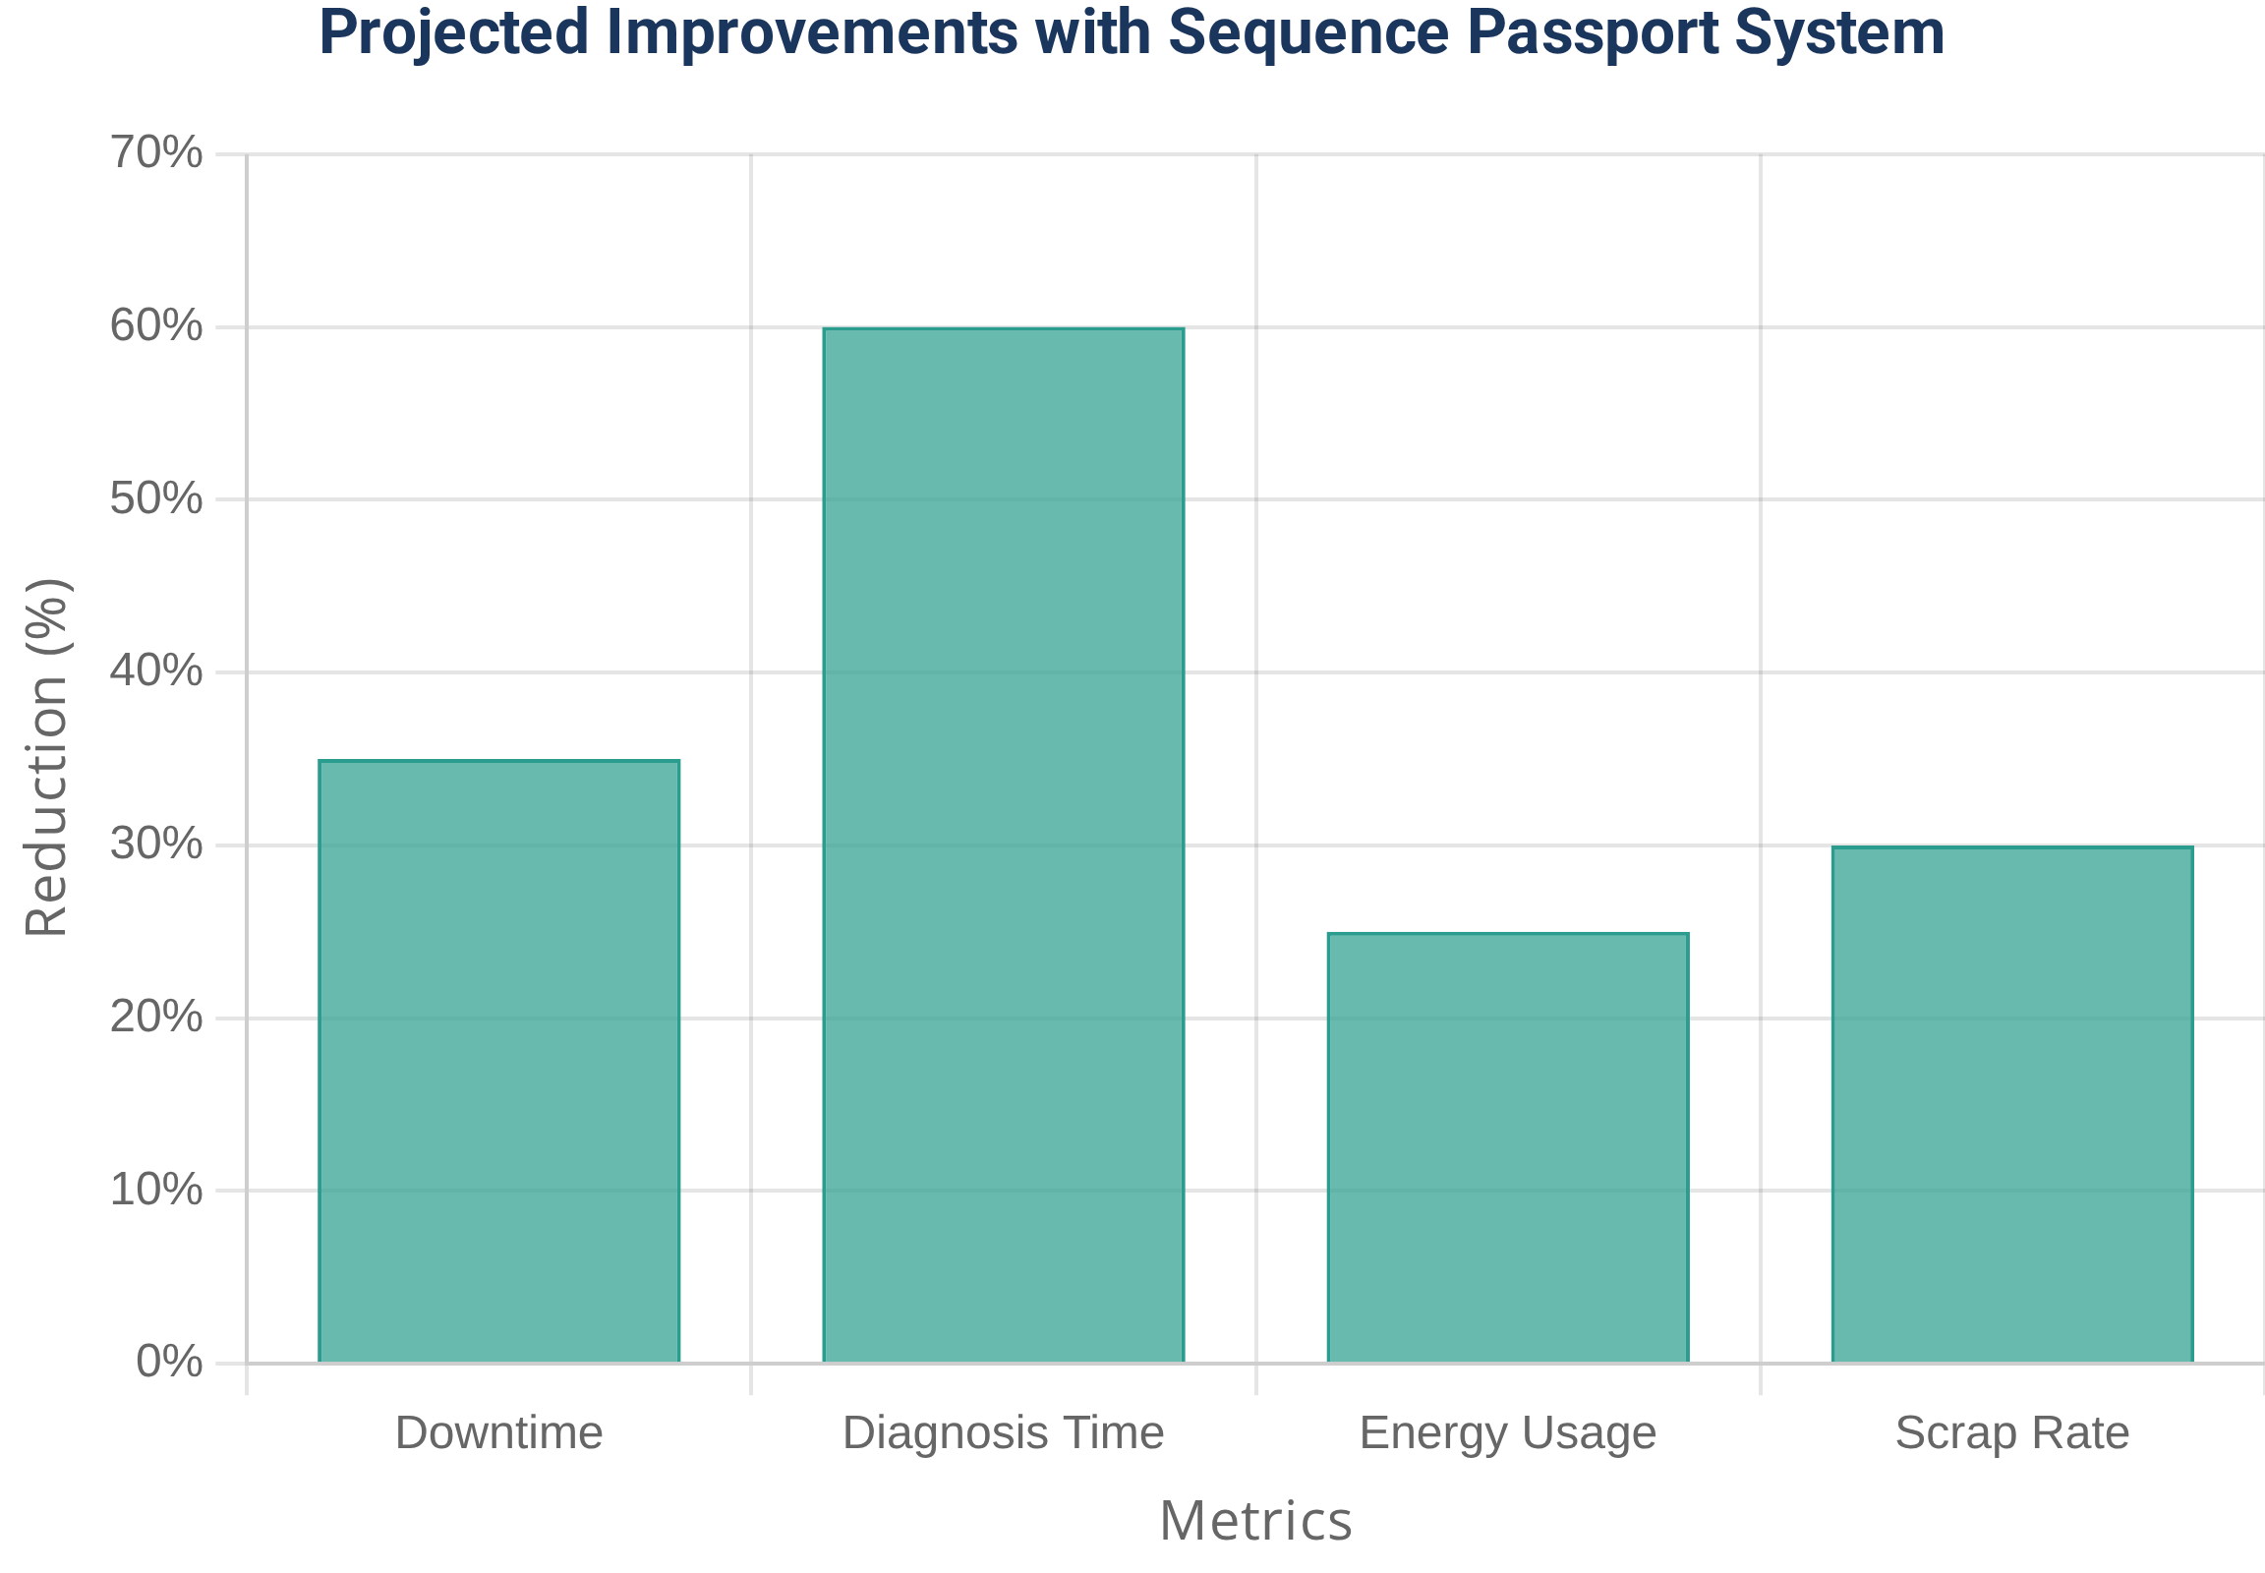




System Architecture: From Data to Insights
Key Advantages
Projected Impact
Faster Diagnosis
Faster Diagnosis
Cost & Energy Savings
Scrap Rate Reduction
Visibility into Hidden Patterns
Stronger Process Control

